Slide 1
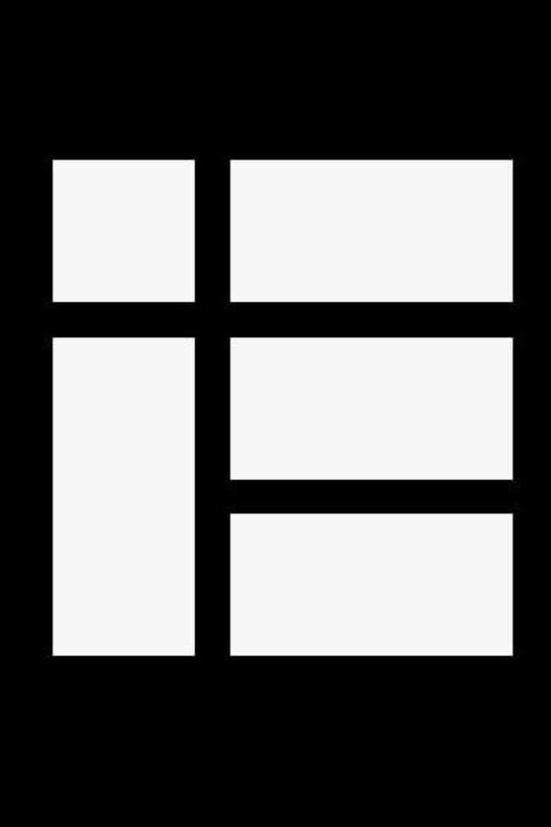

Kotlin Basic Types
Numbers

Slide 2
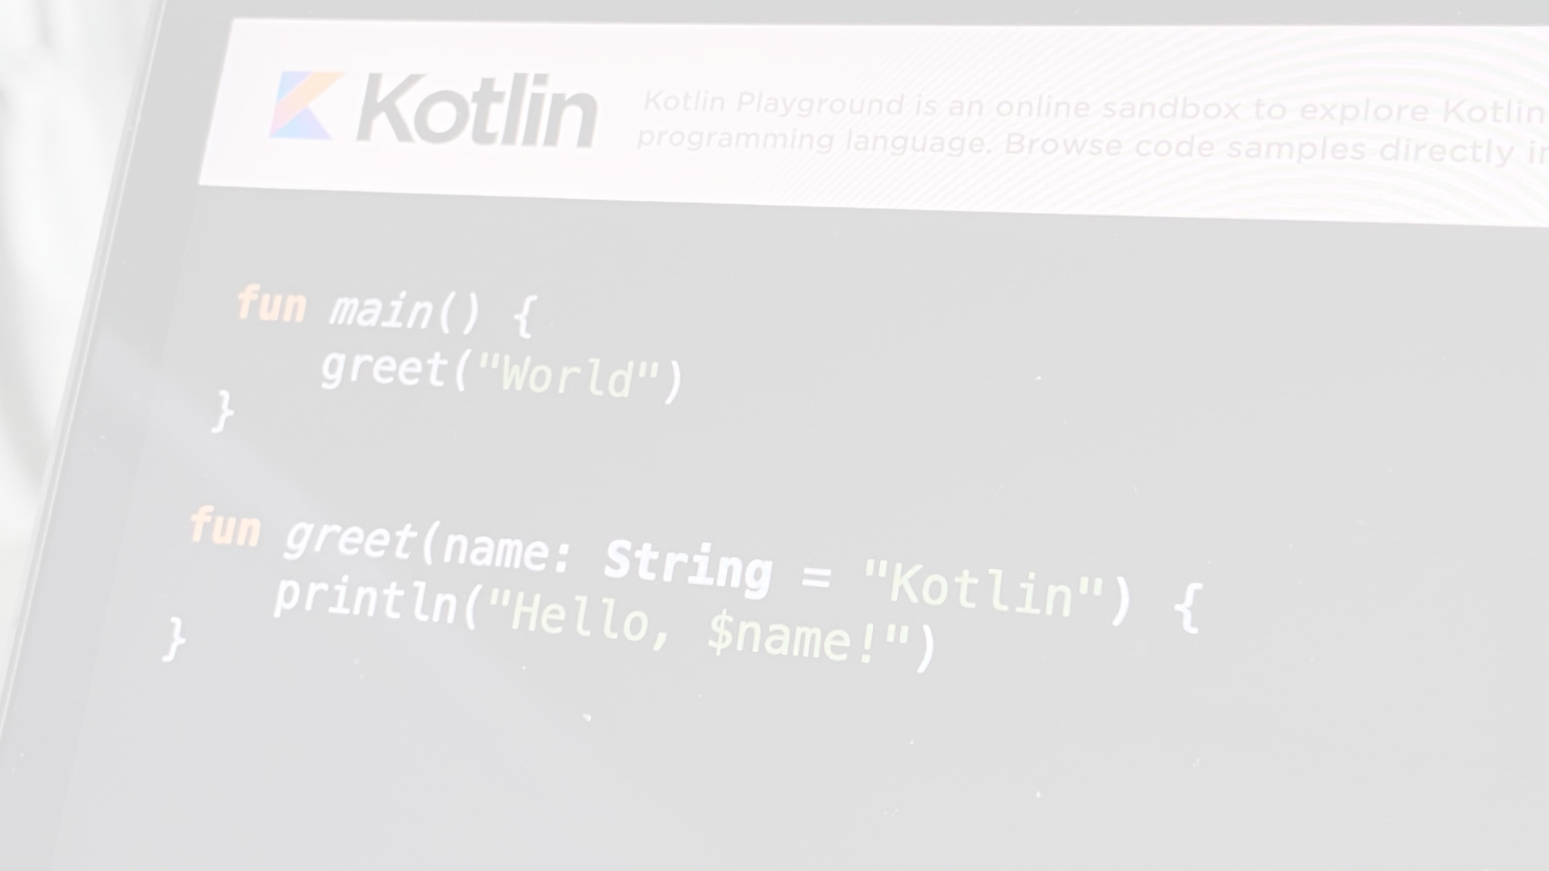
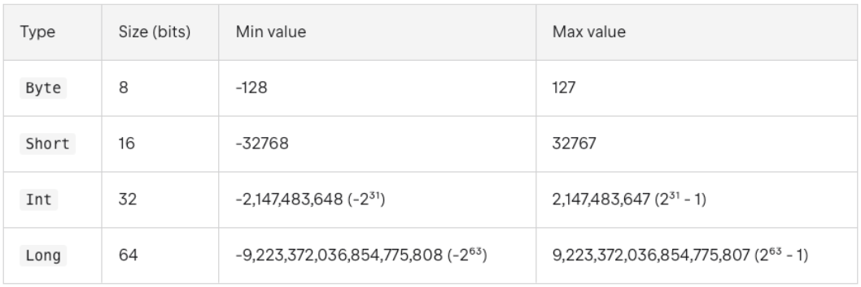
Integer Types
﻿Kotlin provides a set of built-in types that represent numbers. For integer numbers, there are four types with different sizes and, hence, value ranges:
When you initialize a variable with no explicit type specification, the compiler automatically infers the type with the smallest range enough to represent the value starting from Int. If it is not exceeding the range of Int, the type is Int. If it exceeds, the type is Long. To specify the Long value explicitly, append the suffix L to the value. Explicit type specification triggers the compiler to check the value not to exceed the range of the specified type
val one = 1 // Int
val threeBillion = 3000000000 // Long
val oneLong = 1L // Long
val oneByte: Byte = 1

Slide 3
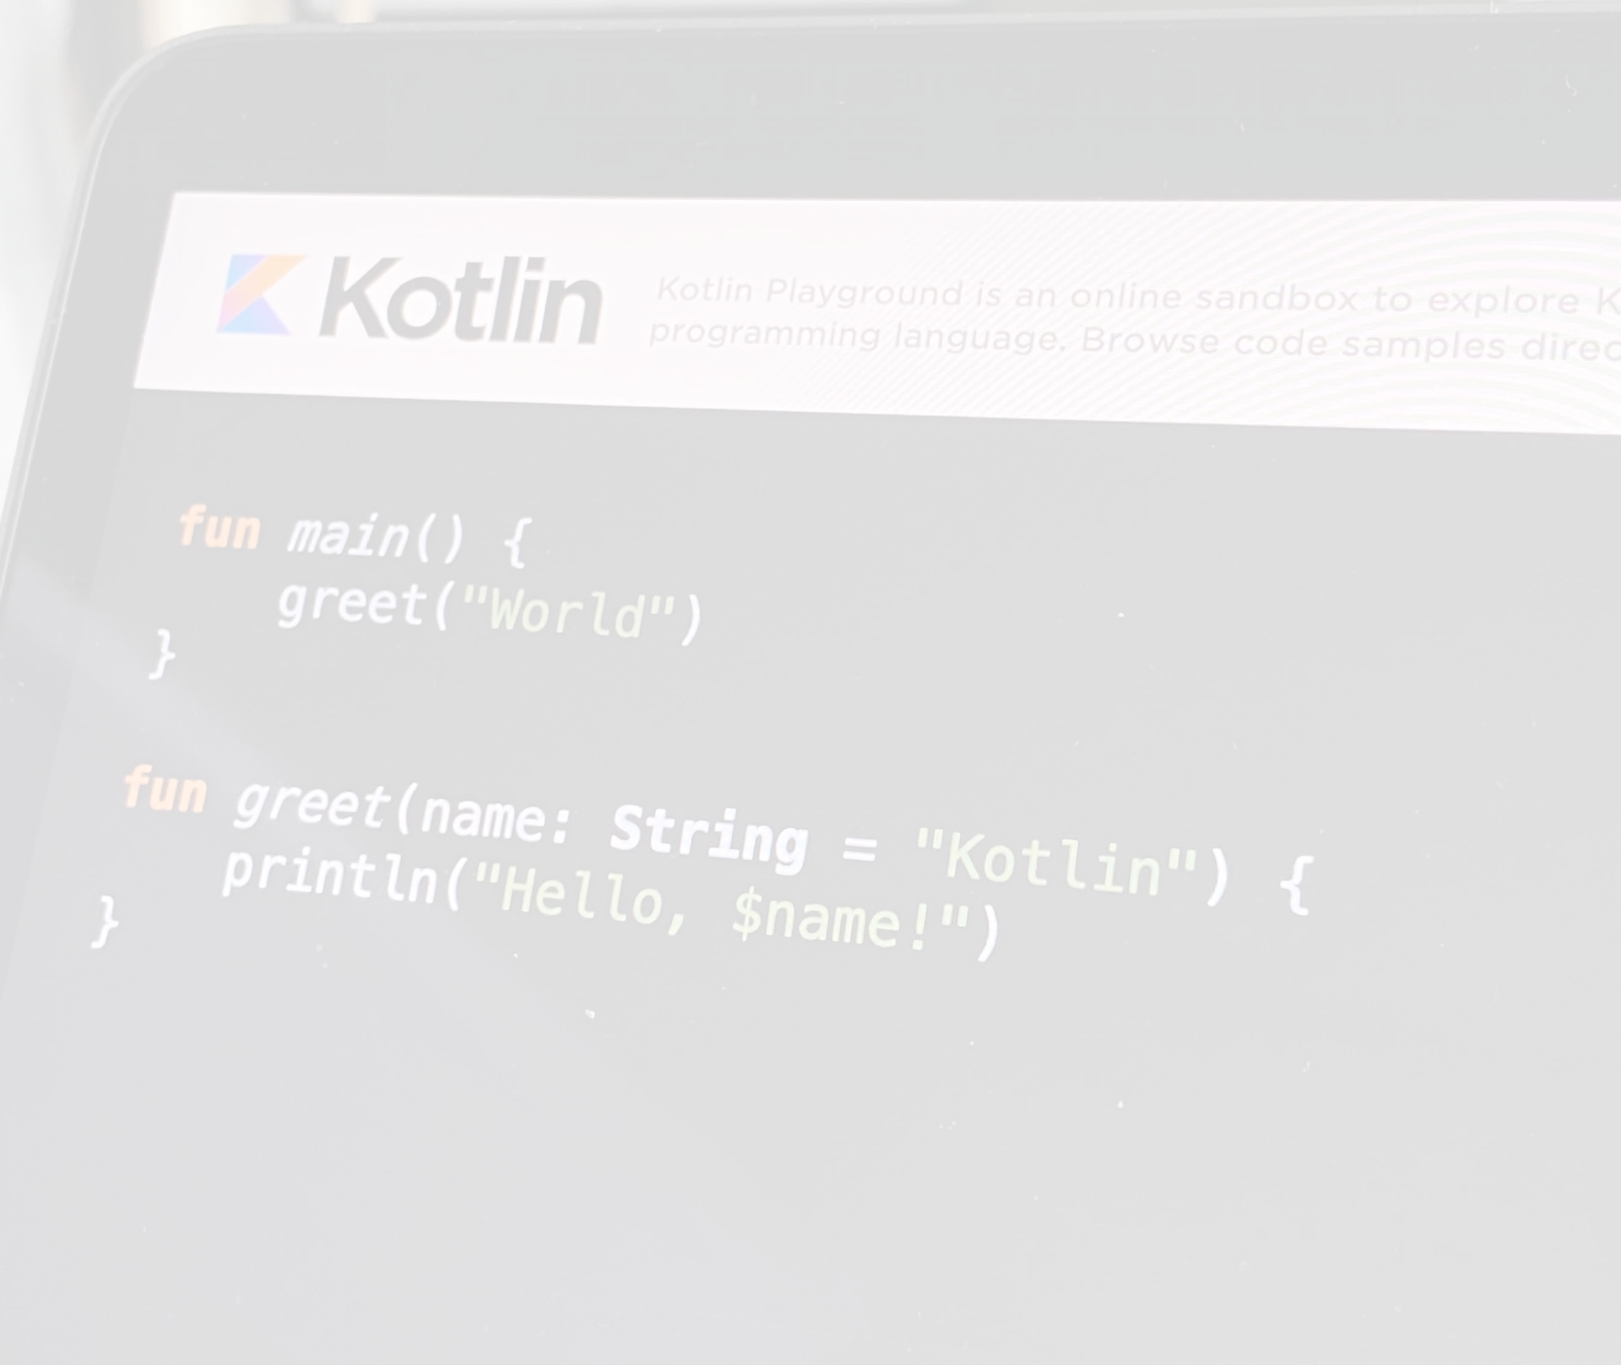
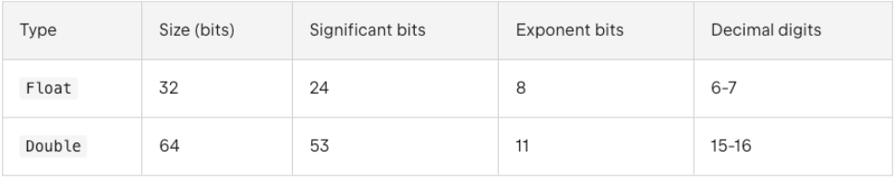
Floating-point types﻿
For real numbers, Kotlin provides floating-point types Float and Double that adhere to the IEEE 754 standard. Float reflects the IEEE 754 single precision, while Double reflects double precision.
These types differ in their size and provide storage for floating-point numbers with different precision:
You can initialize Double and Float variables with numbers having a fractional part. It's separated from the integer part by a period (.) For variables initialized with fractional numbers, the compiler infers the Double type:
val pi = 3.14 // Double
// val one: Double = 1 // Error: type mismatch
val oneDouble = 1.0 // Double
To explicitly specify the Float type for a value, add the suffix f or F. If such a value contains more than 6-7 decimal digits, it will be rounded:
val e = 2.7182818284 // Double
val eFloat = 2.7182818284f // Float, actual value is 2.7182817
Unlike some other languages, there are no implicit widening conversions for numbers in Kotlin. For example, a function with a Double parameter can be called only on Double values, but not Float, Int, or other numeric values:
fun main() {
fun printDouble(d: Double) { print(d) }
val i = 1
val d = 1.0
val f = 1.0f
printDouble(d)
// printDouble(i) // Error: Type mismatch
// printDouble(f) // Error: Type mismatch
}

Slide 4
Literal Constants for Numbers﻿
There are the following kinds of literal constants for integral values:
Decimals: 123
Longs are tagged by a capital L: 123L
Hexadecimals: 0x0F
Binaries: 0b00001011
Kotlin also supports a conventional notation for floating-point numbers:
Doubles by default: 123.5, 123.5e10
Floats are tagged by f or F: 123.5f
You can use underscores to make number constants more readable
val oneMillion = 1_000_000
val creditCardNumber = 1234_5678_9012_3456L
val socialSecurityNumber = 999_99_9999L
val hexBytes = 0xFF_EC_DE_5E
val bytes = 0b11010010_01101001_10010100_10010010

Slide 5
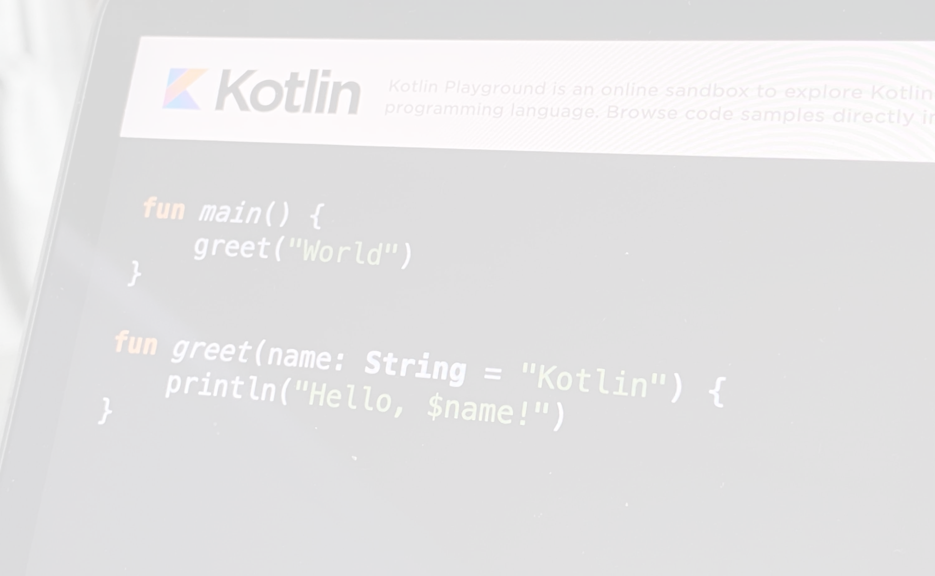
Numbers representation on the JVM﻿
On the JVM platform, numbers are stored as primitive types: int, double, and so on. Exceptions are cases when you create a nullable number reference such as Int? or use generics. In these cases numbers are boxed in Java classes Integer, Double, and so on.
Nullable references to the same number can refer to different objects:
val a: Int = 100
val boxedA: Int? = a
val anotherBoxedA: Int? = a
​
val b: Int = 10000
val boxedB: Int? = b
val anotherBoxedB: Int? = b
​
println(boxedA === anotherBoxedA) // true
println(boxedB === anotherBoxedB) // false
All nullable references to a are actually the same object because of the memory optimization that JVM applies to Integers between -128 and 127. It doesn't apply to the b references, so they are different objects.
On the other hand, they are still equal:
val b: Int = 10000
println(b == b) // Prints 'true'
val boxedB: Int? = b
val anotherBoxedB: Int? = b
println(boxedB == anotherBoxedB) // Prints 'true'

Slide 6
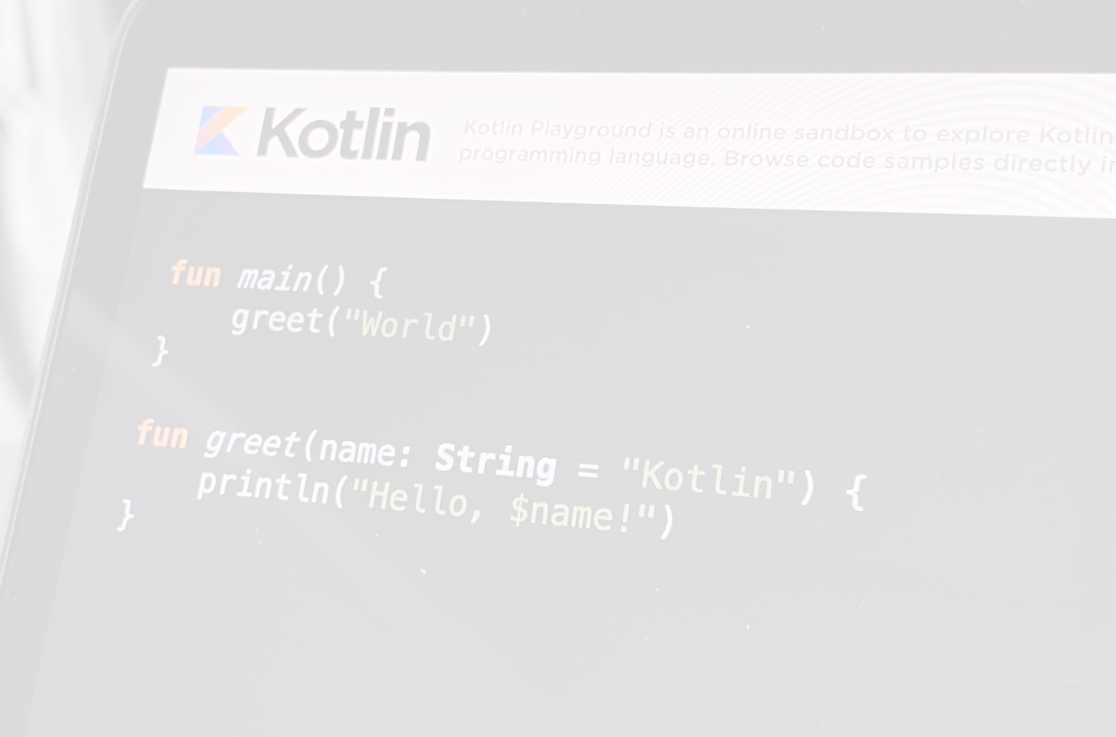
Explicit Number Conversions﻿
Due to different representations, smaller types are not subtypes of bigger ones. If they were, we would have troubles of the following sort:
// Hypothetical code, does not actually compile:
val a: Int? = 1 // A boxed Int (java.lang.Integer)
val b: Long? = a // Implicit conversion yields a boxed Long (java.lang.Long)
print(b == a) // Surprise! This prints "false" as Long's equals() checks whether the other is Long as well
So equality would have been lost silently, not to mention identity.
As a consequence, smaller types are NOT implicitly converted to bigger types. This means that assigning a value of type Byte to an Int variable requires an explicit conversion:
val b: Byte = 1 // OK, literals are checked statically
// val i: Int = b // ERROR
val i1: Int = b.toInt()
All number types support conversions to other types:
toByte(): Byte
toShort(): Short
toInt(): Int
toLong(): Long
toFloat(): Float
toDouble(): Double
In many cases, there is no need for explicit conversions because the type is inferred from the context, and arithmetical operations are overloaded for appropriate conversions, for example:
val l = 1L + 3 // Long + Int => Long

Slide 7
Operations on Numbers﻿
Kotlin supports the standard set of arithmetical operations over numbers: +, -, *, /, %. They are declared as members of appropriate classes:
println(1 + 2) // 3
println(2_500_000_000L - 1L) // 2499999999
println(3.14 * 2.71) // 8.5094
println(10.0 / 3) // 3.3333333333333335

